Slide 1
WELCOME TO OUR PRESENTATION
PROJECT: PRODUCT MANAGEMENT

Slide 2
COURSE CO-ORDINATOR: ASIF HOSSAIN
GROUP MEMBERS:
Tarek Bari Chowdhury-13101083
Hasibul Hasan - 13101099
Shariyat Imran - 13101103

Slide 3
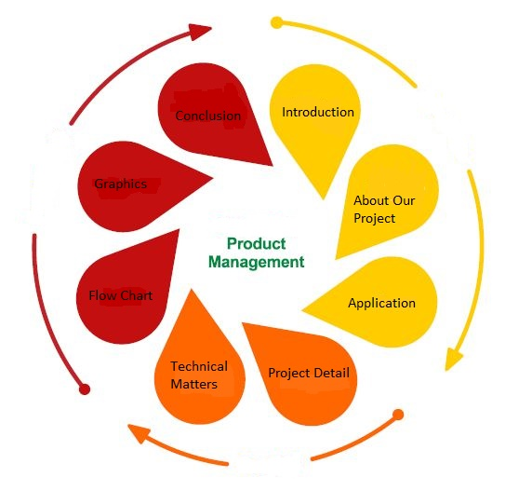
Content

Slide 4
Introduction
Product management is an organizational lifecycle function within a super market dealing with the planning, forecasting, or marketing of a product or products at all stages of the product lifecycle.

Slide 5
About Our Project
The role may consist of product development and the role may consist of product development and product marketing, which are different efforts, with the objective of maximizing sales revenues, market share, and profit margins. The product manager is often responsible for analyzing market conditions and defining features or functions of a product.

Slide 6
Application
To develop, sell and support a successful software product a business needs to understand its market, identify the opportunity, develop and market an appropriate piece of software.

Slide 7
Project Detail
At first take data in a text file.
Take product type another text file.
Choose the brand name.
See the details .

Slide 8
Flow Chart
SHOP
PRODUCT MANAGER
CHOOSE
PRODUCT
BRAND
COUNT
PRICE
WEIGHT
END

Slide 9
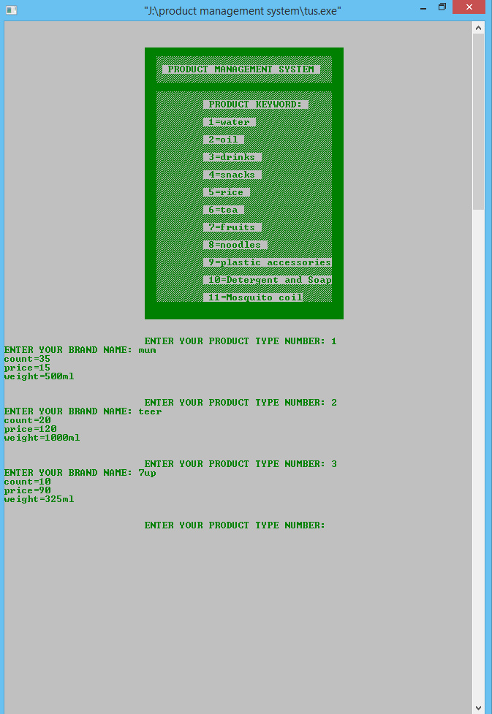
PROJECT CONSOLE

Slide 10
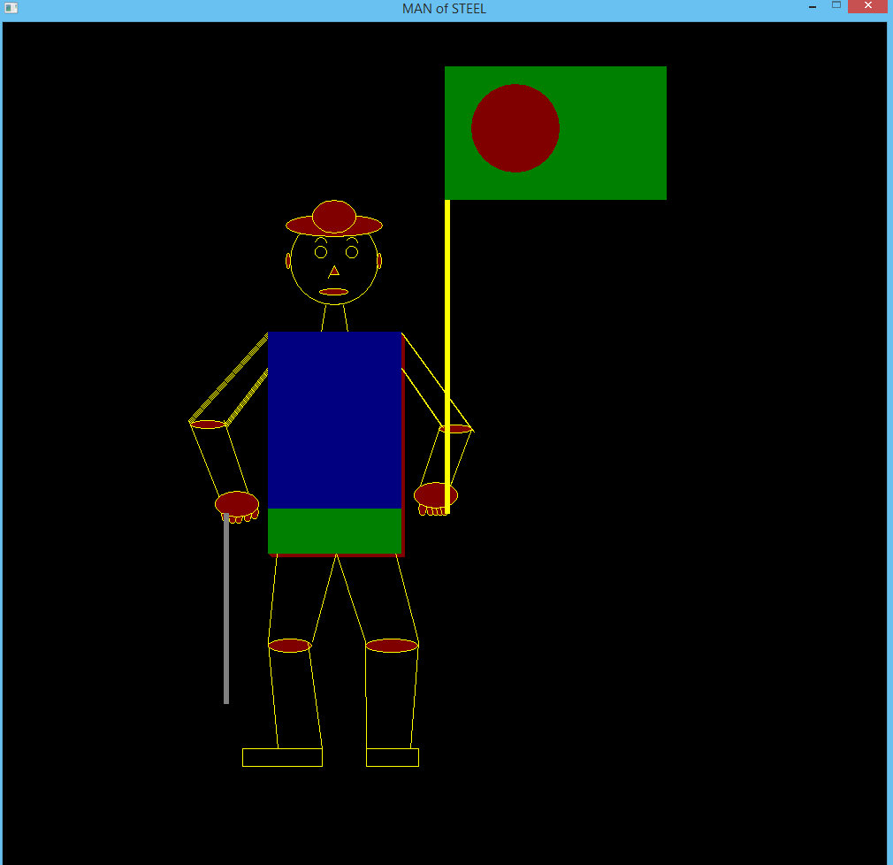
Graphics
Our
graphics
work

Slide 11
FUTURE PLAN
Most technology companies have a product management department serving as the “voice of the customer” and helping to better understand market needs.

Slide 12
THIS IS THE END OF OUR PRESENTATION
THANK YOU EVERYONE.

